Slide 1
Introduction to gRPC Service
Notes:
https://grpc.io/

Slide 2
Objectives
Learn the gRPC theory to understand how gRPC works
Compare gRPC and REST API paradigm
Write your gRPC service definition in .proto files
gRPC services on ASP.NET Core

Slide 3
gRPC - 1
gRPC stands for gRPC Remote Procedure Calls
gRPC is a new and modern framework for building scalable, modern and fast API.
It is leveraged by many top tech companies such as Google, Square & Netflix and enables programmers to write micro-services in any language they want while keeping the ability to easily create communications between these services.
It relies on Protocol Buffers for the transport mechanism and Service Definition language.

Slide 4
gRPC - 2
The main benefits of gRPC are:
Modern, high-performance, lightweight RPC framework.
Contract-first API development, using Protocol Buffers by default, allowing for language agnostic implementations.
Tooling available for many languages to generate strongly-typed servers and clients.
Supports client, server, and bi-directional streaming calls.
Reduced network usage with Protobuf binary serialization.

Slide 5
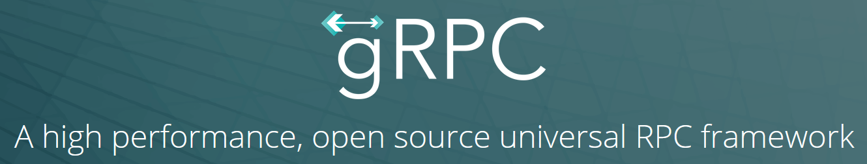
gRPC - 3
The benefits make gRPC ideal for:
Lightweight microservices where efficiency is critical.
Polyglot systems where multiple languages are required for development.
Point-to-point real-time services that need to handle streaming requests or responses.

Slide 6
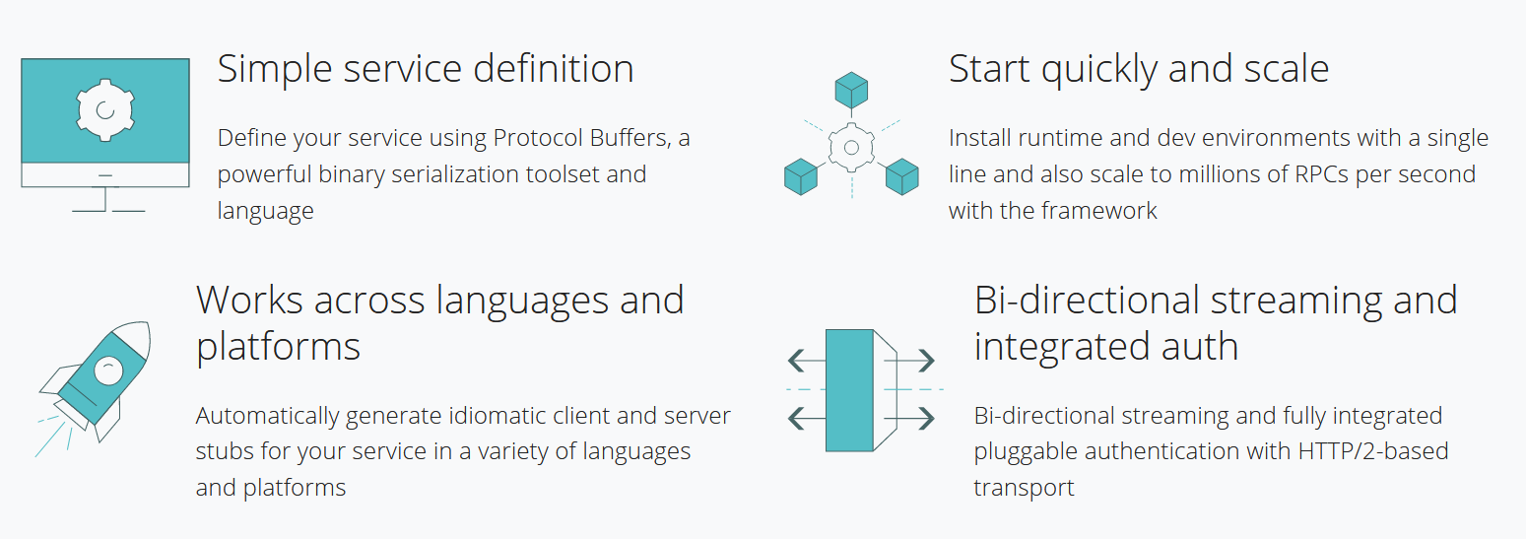
Why gRPC? - 1

Slide 7

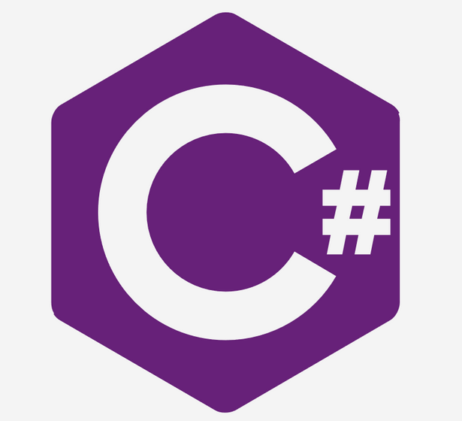

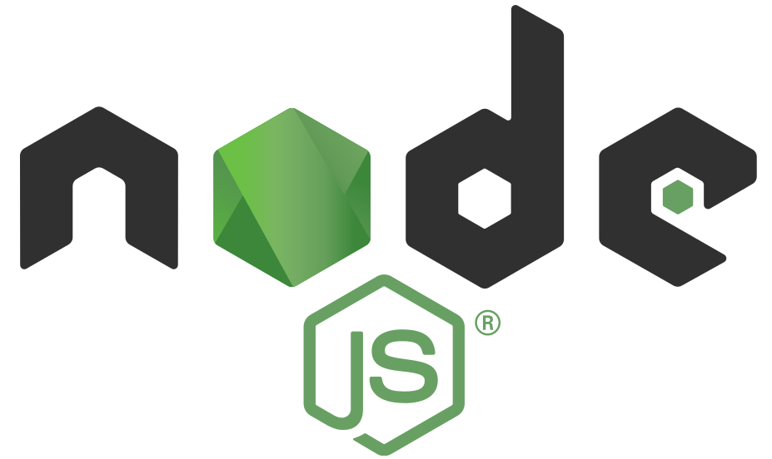
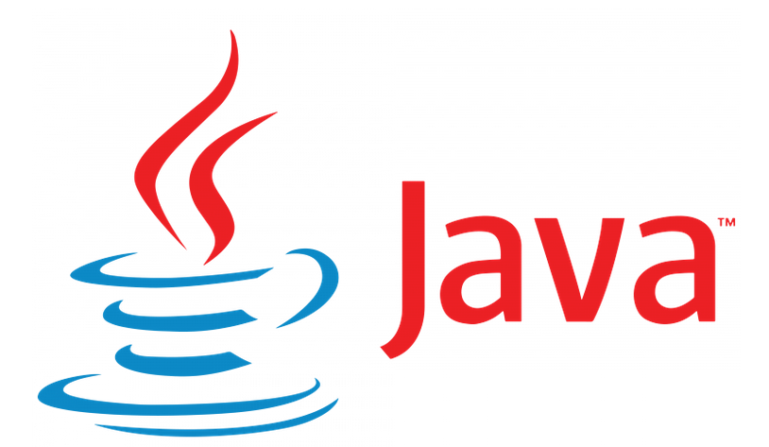

Why gRPC? - 2
Works across languages and platforms
C#, C++, Dart, Go, Java, Kotlin, Node, Objective-C, PHP, Python, Ruby

Slide 8
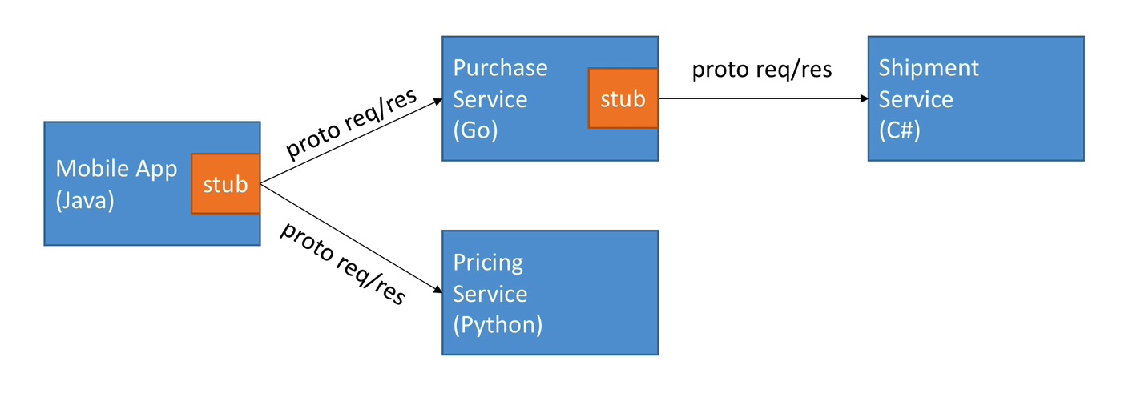
Why gRPC? - 3
Works across languages and platforms (contd.)

Slide 9
Protocol Buffers vs. JSON - 1
Protocol buffers, also known as Protobuf, is a protocol that Google developed internally to enable serialization and deserialization of structured data between different services.
Google’s design goal was to create a better method than XML to make systems communicate with each other over a wire or for the storage of data.
Since its development, Google has made Protobuf under an open source license.
It also provides out of the box support in the most common languages, including Python, Java, Objective-C, C# and others via Google’s new proto3 language version.

Slide 10
Protocol Buffers vs. JSON - 2
JSON, or JavaScript Object Notation, is a minimal, readable format also used to structure data.
It is also an alternative to XML and is mainly used as a way of transmitting data between a server and web application.
JSON uses human-readable way as a way of transmitting data objects made up of attribute-value pairs and array data types (or another type of serializable value).
JSON was derived from JavaScript, but since last year multiple programming languages include code to generate and parse JSON-format data.

Slide 11
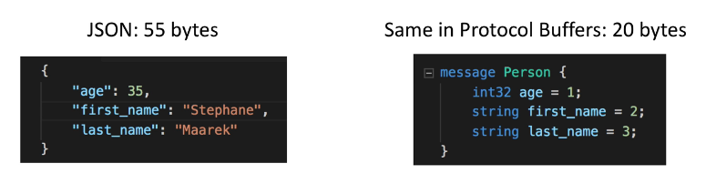
Protocol Buffers vs. JSON - 3
Parsing JSON is actually CPU intensive (because the format is human readable)
Parsing Protocol Buffers (binary format) is less CPU intensive because it’s closer to how a machine represents data
By using gRPC, the use of Protocol Buffers means faster and more efficient communication, friendly with mobile devices and have a slower CPU.
gRPC uses Protocol Buffers, Google’s mature open source mechanism for serializing structured data (although it can be used with other data formats such as JSON).

Slide 12
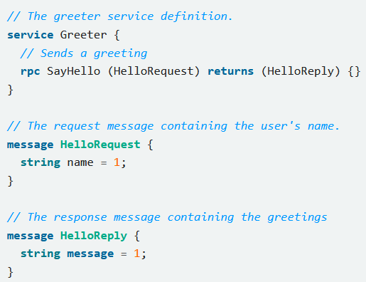
Protocol Buffers role in gRPC
Protocol Buffers is used to define the
Messages (data, Request and Response)
Service (Service name and RPC endpoints)

Slide 13
Protocol Buffer versions
While protocol buffers have been available to open source users for some time, most examples use protocol buffers version 3 (proto3), which has a slightly simplified syntax, some useful new features, and supports more languages.
Proto3 is currently available in Java, C++, Dart, Python, Objective-C, C#, a lite-runtime (Android Java), Ruby, and JavaScript from the protocol buffers GitHub repo.
In general, while you can use proto2 (the current default protocol buffers version), we recommend that you use proto3 with gRPC as it lets you use the full range of gRPC-supported languages, as well as avoiding compatibility issues with proto2 clients talking to proto3 servers and vice versa.

Slide 14
gRPC Core Concepts
Service definition
Using the API
Synchronous vs. asynchronous

Slide 15
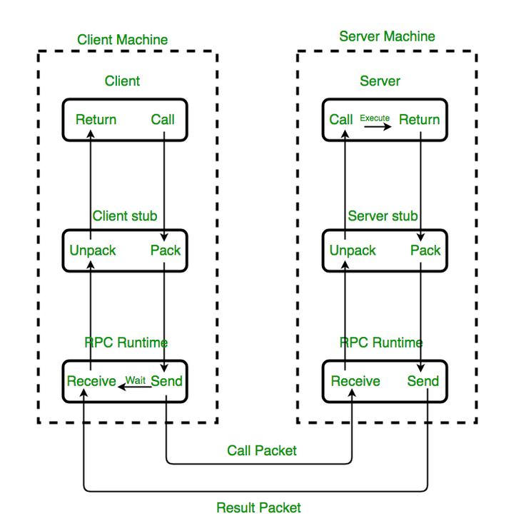
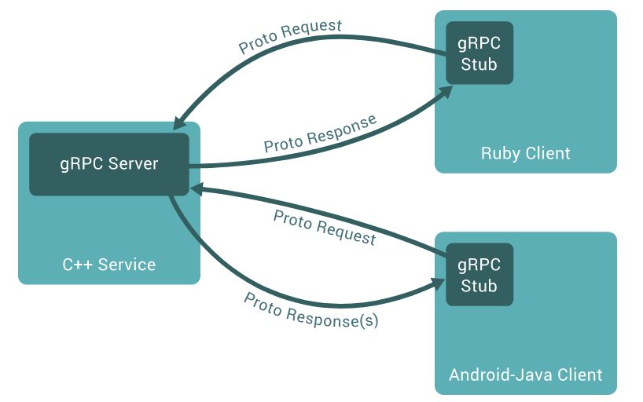
gRPC Architecture
The rough architecture of gRPC. It's more or less the same as regular RPC
gRPC clients and servers can run and talk to each other in a variety of environments

Slide 16
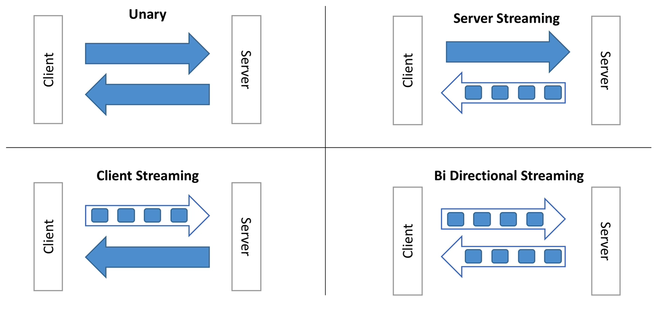
gRPC Lifecycle - 1
4 Types of API in gRPC

Slide 17
gRPC Lifecycle - 2
4 types of API in gRPC
Unary RPC - Unary RPCs where the client sends a single request to the server and gets a single response back, just like a normal function call.
Server streaming RPC - Server streaming RPCs where the client sends a request to the server and gets a stream to read a sequence of messages back. The client reads from the returned stream until there are no more messages. gRPC guarantees message ordering within an individual RPC call.

Slide 18
gRPC Lifecycle - 3
4 types of API in gRPC (contd.)
Client streaming RPC - Client streaming RPCs where the client writes a sequence of messages and sends them to the server, again using a provided stream. Once the client has finished writing the messages, it waits for the server to read them and return its response. Again gRPC guarantees message ordering within an individual RPC call.
Bidirectional streaming RPC - Bidirectional streaming RPCs where both sides send a sequence of messages using a read-write stream. The two streams operate independently, so clients and servers can read and write in whatever order they like: for example, the server could wait to receive all the client messages before writing its responses, or it could alternately read a message then write a message, or some other combination of reads and writes. The order of messages in each stream is preserved.

Slide 19
gRPC Lifecycle - 4
Deadlines/Timeouts
gRPC allows clients to specify how long they are willing to wait for an RPC to complete before the RPC is terminated with a DEADLINE_EXCEEDED error. On the server side, the server can query to see if a particular RPC has timed out, or how much time is left to complete the RPC.
Specifying a deadline or timeout is language specific: some language APIs work in terms of timeouts (durations of time), and some language APIs work in terms of a deadline (a fixed point in time) and may or may not have a default deadline.

Slide 20
gRPC Lifecycle - 5
RPC termination
In gRPC, both the client and server make independent and local determinations of the success of the call, and their conclusions may not match.
This means that, for example, you could have an RPC that finishes successfully on the server side (“I have sent all my responses!") but fails on the client side (“The responses arrived after my deadline!"). It’s also possible for a server to decide to complete before a client has sent all its requests.
Cancelling an RPC
Either the client or the server can cancel an RPC at any time. A cancellation terminates the RPC immediately so that no further work is done.

Slide 21
gRPC Lifecycle - 5
Metadata
Metadata is information about a particular RPC call (such as authentication details) in the form of a list of key-value pairs, where the keys are strings and the values are typically strings, but can be binary data.
Metadata is opaque to gRPC itself - it lets the client provide information associated with the call to the server and vice versa.
Access to metadata is language dependent.

Slide 22
gRPC Lifecycle - 6
Channels
A gRPC channel provides a connection to a gRPC server on a specified host and port. It is used when creating a client stub.
Clients can specify channel arguments to modify gRPC’s default behavior, such as switching message compression on or off.
A channel has state, including connected and idle.
How gRPC deals with closing a channel is language dependent. Some languages also permit querying channel state.

Slide 23
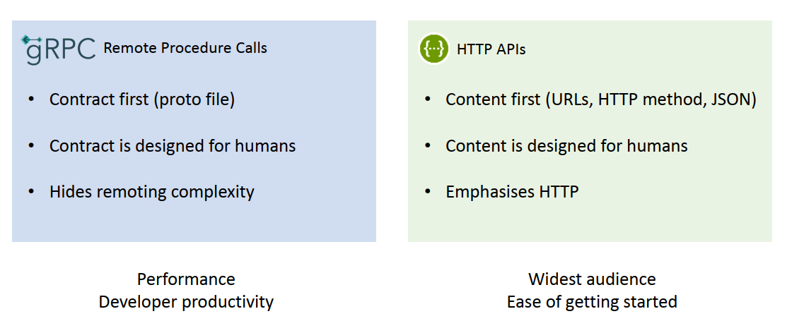
Remote Procedure Calls vs HTTP APIs

Slide 24
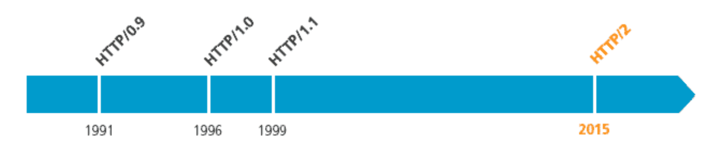
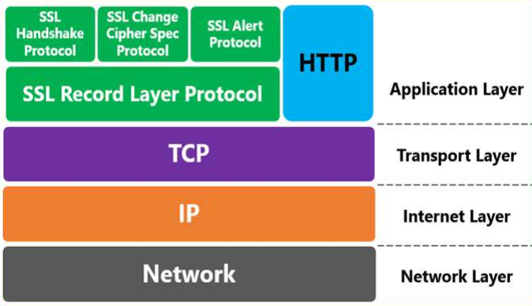
HTTP/2 - 1
HTTP 2.0 specification was published as RFC 7540 in May 2015.

Slide 25
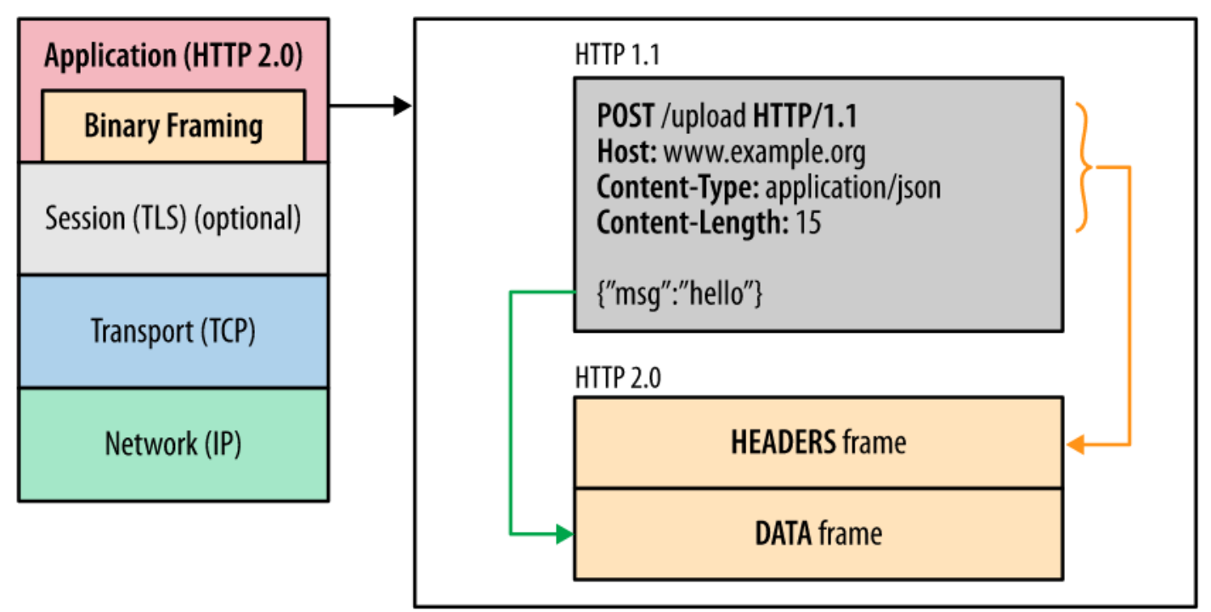
HTTP/2 - 2
The HTTP request/response gets broken down into frames.
The headers frame contains typical HTTP headers information.
The data frame contains the payload.

Slide 26
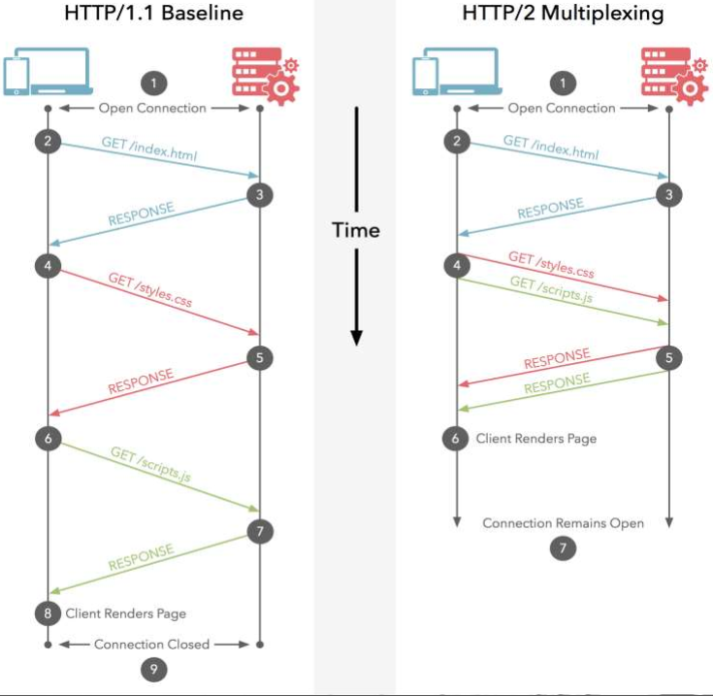
HTTP/2 Features - 1
Binary Protocol. HTTP/2 is binary, instead of textual
More efficient to parse
More compact on the wire
Much less error prone as compared to textual protocols
Multiplexing
Allows messages to be interleaved together on a connection at the same time thus allowing multiple requests and response messages to be in flight at the same time

Slide 27
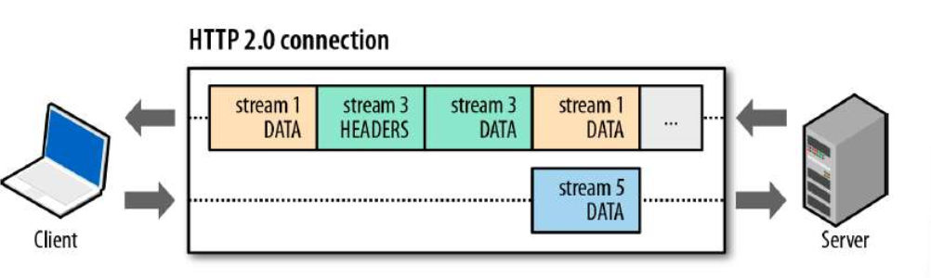
HTTP/2 Features - 2
Header Compression
Avoid Head of Line blocking
Prioritization of Frames
HTTP/2 splits the communication in frames.
All frames are sent over a single TCP connection
Frames are interleaved.
Frames are Prioritized.
Frames are flow controlled

Slide 28
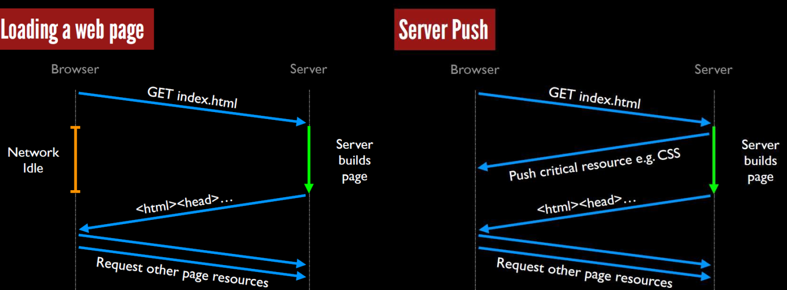
HTTP/2 Features - 3
Server Push
Allows server to push responses proactively into client caches for future use.
Helps avoid round trip between fetching HTML and linked stylesheets and scripts as server can start sending these things right away without waiting for client to request them.

Slide 29
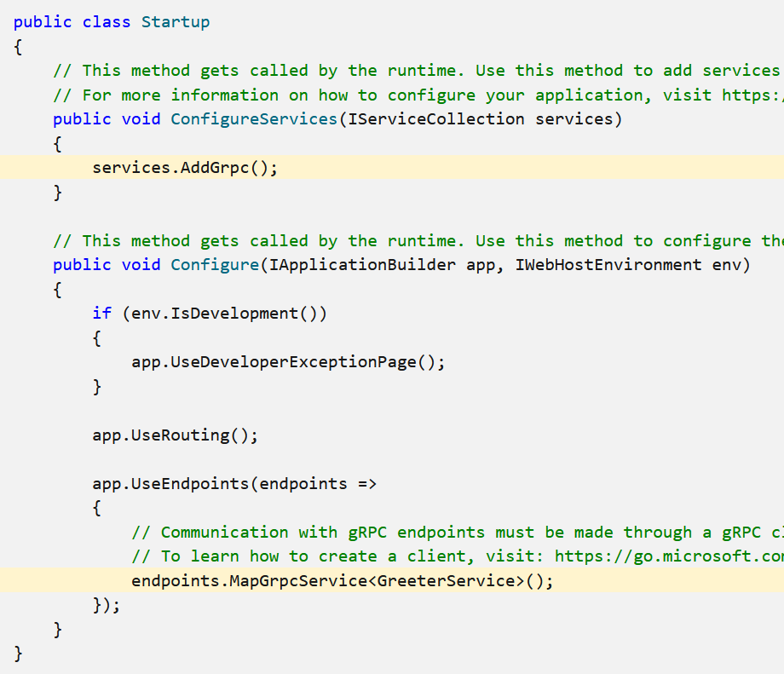
gRPC services on ASP.NET Core - 1
Add gRPC services to an ASP.NET Core app
gRPC requires the Grpc.AspNetCore package.
Configure gRPC in a .NET app.
Notes:
gRPC docs – https://docs.microsoft.com/aspnet/core/grpc • gRPC with ASP.NET Core authentication • Logging and diagnostics • HttpClientFactory integration

Slide 30
gRPC services on ASP.NET Core - 2
gRPC services can be hosted by all built-in ASP.NET Core servers.
Kestrel
TestServer
IIS (IIS requires .NET 5 and Windows 10 Build 20300.1000 or later)
HTTP.sys (HTTP.sys requires .NET 5 and Windows 10 Build 19529 or later.)

Slide 31
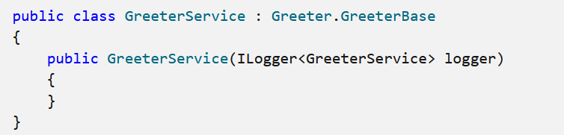
Integration with ASP.NET Core APIs
gRPC services have full access to the ASP.NET Core features such as Dependency Injection (DI) and Logging.
The service implementation can resolve a logger service from the DI container via the constructor.
By default, the gRPC service implementation can resolve other DI services with any lifetime (Singleton, Scoped, or Transient).

Slide 32
GrpcGreeter project files
greet.proto: The Protos/greet.proto file defines the Greeter gRPC and is used to generate the gRPC server assets.
Services folder: Contains the implementation of the Greeter service.
appSettings.json: Contains configuration data, such as protocol used by Kestrel.
Program.cs: Contains the entry point for the gRPC service.
Startup.cs: Contains code that configures app behavior.

Slide 33
gRPC Service Demo

Slide 34
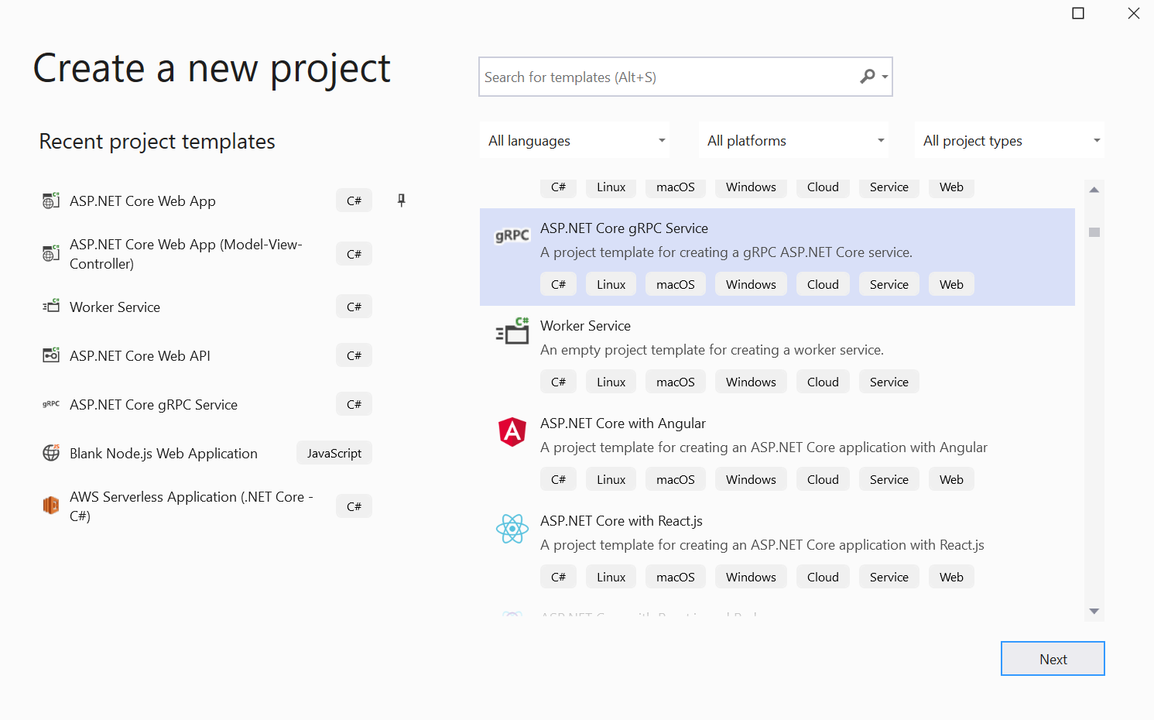
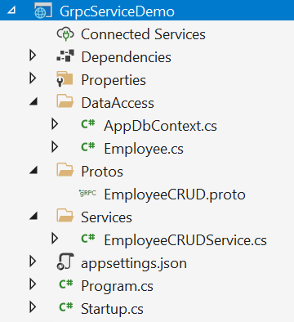
Create a gRPC Service Project

Slide 35
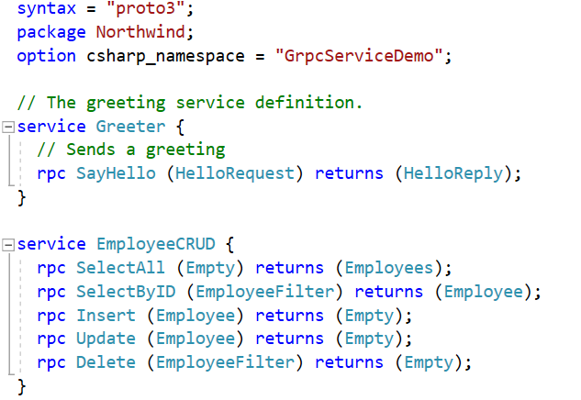
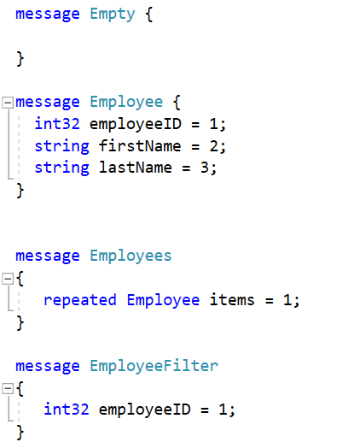
Create EmployeeCRUD.proto
This file contains instructions of Protocol Buffer language. The primary purpose of this file is to define the structure of a service you wish to create. Structure of a service includes its methods, method signatures, and types needed by the service.

Slide 36
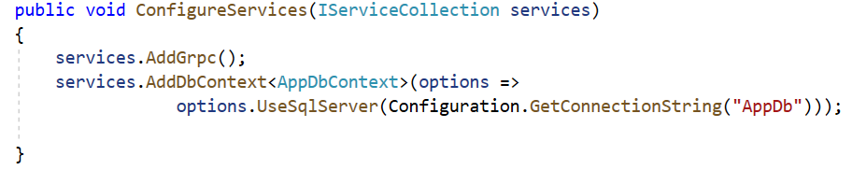
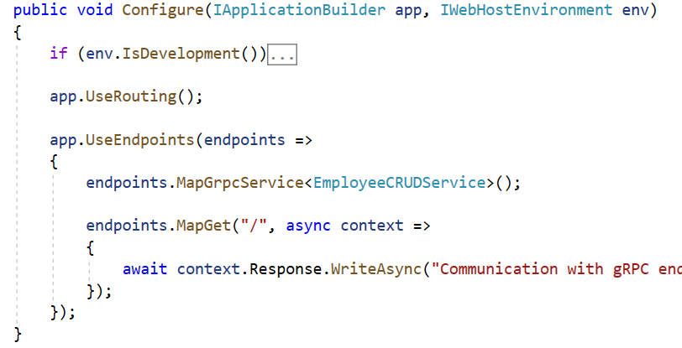
gRPC Service Configuration

Slide 37

Connection String and Service Collection
appsettings.json
Startup.cs

Slide 38
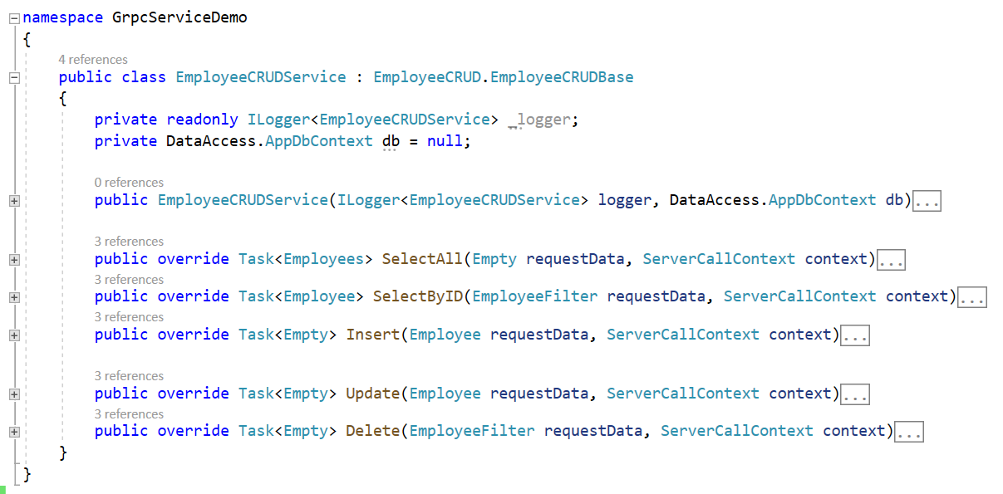
Create EmployeeCRUDService - 1

Slide 39
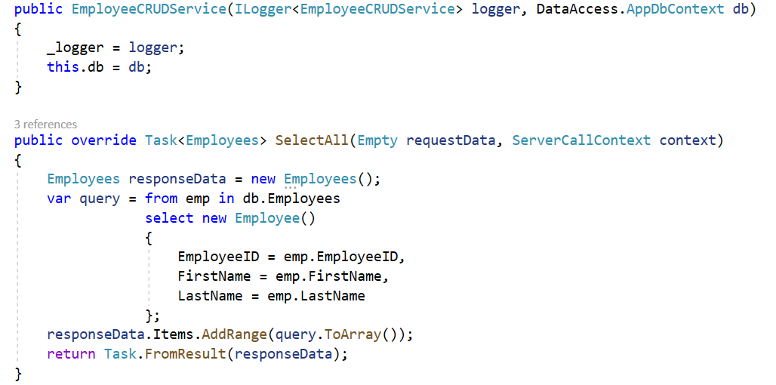
Create EmployeeCRUDService - 2

Slide 40
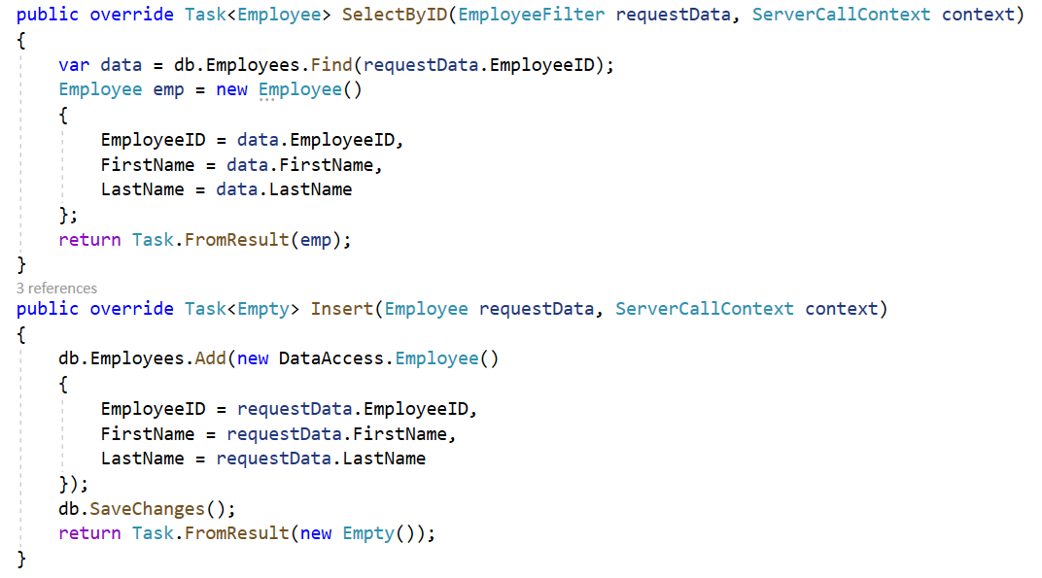
Create EmployeeCRUDService - 3

Slide 41
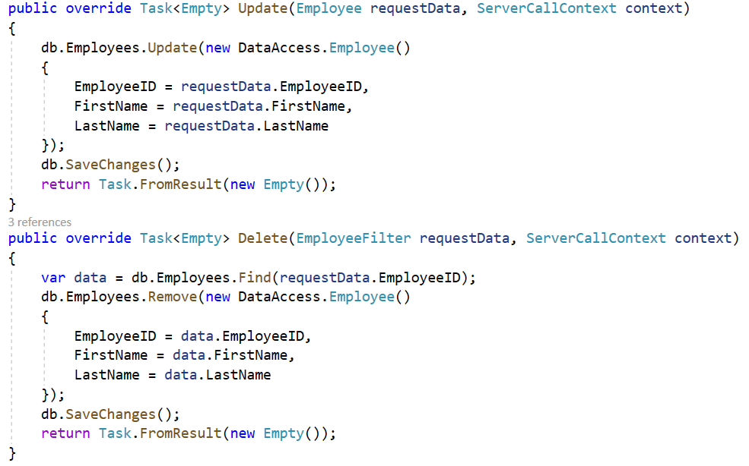
Create EmployeeCRUDService - 4

Slide 42
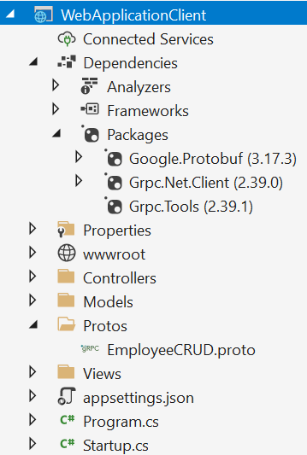
Create the gRPC Client in .NET
Install-Package Grpc.Net.Client
Install-Package Google.Protobuf
Install-Package Grpc.Tools

Slide 43
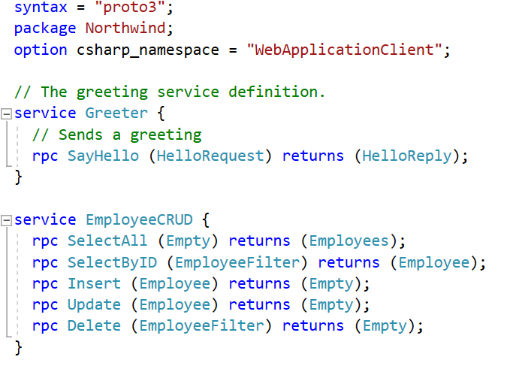
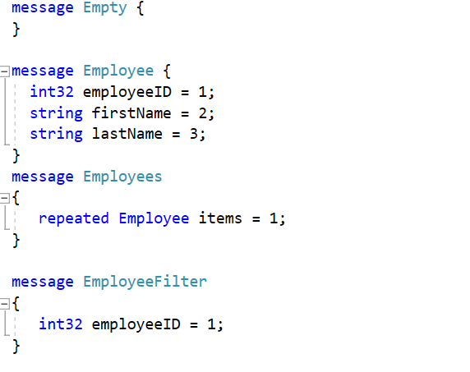
Add greet.proto to Client Project

Slide 44
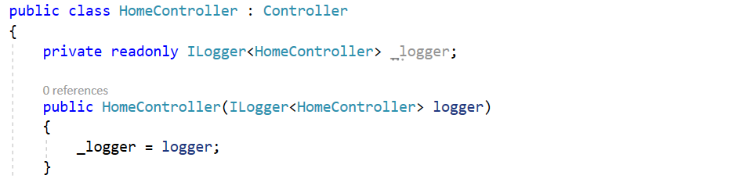
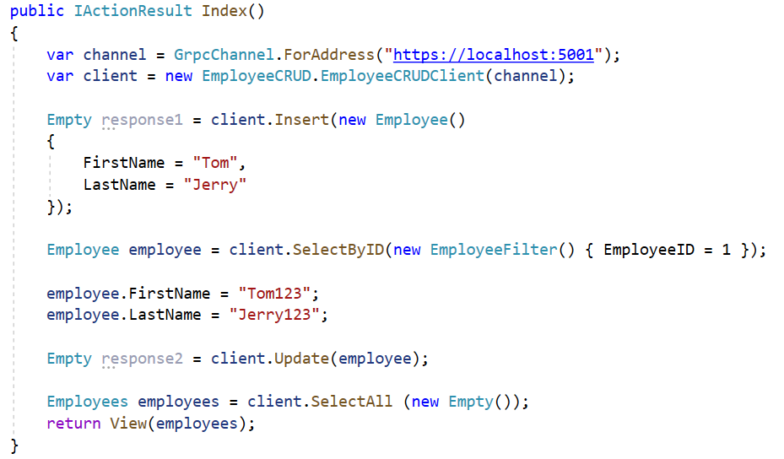
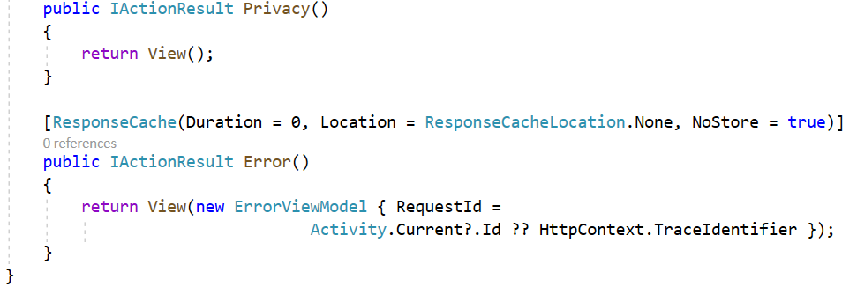
Client Controller

Slide 45
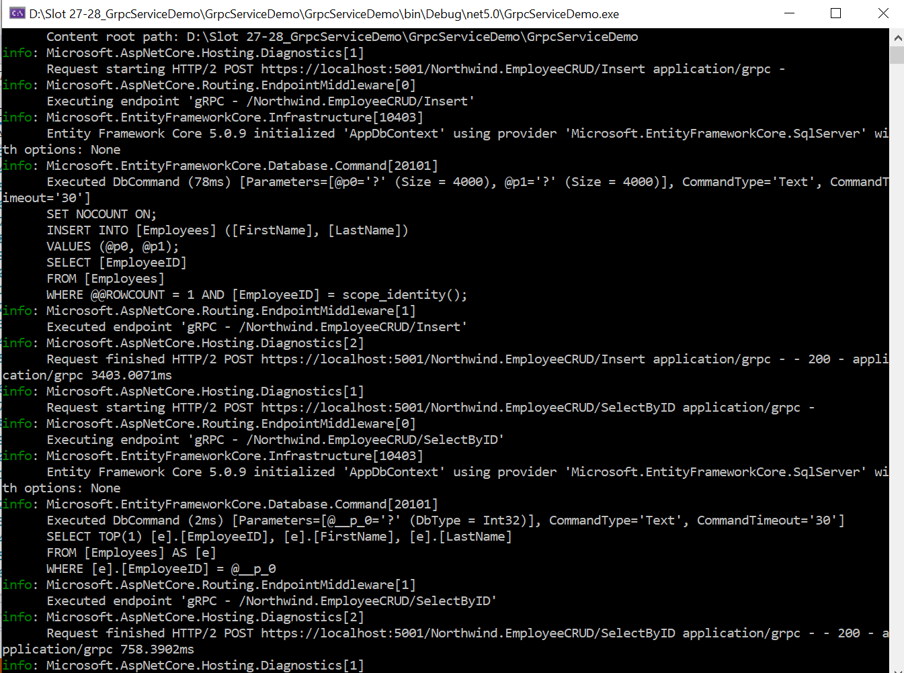
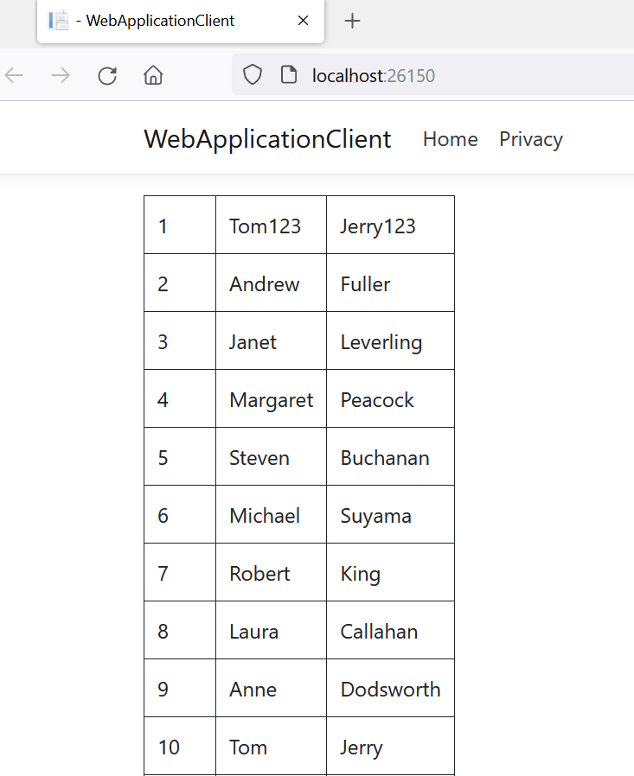
Run Project

Slide 46
Summary
Concepts were introduced:
gRPC Core Concepts
gRPC Architecture
gRPC Lifecycle
Compare gRPC and REST API paradigm
Write your gRPC service definition in .proto files
gRPC services on ASP.NET Core
gRPC Service Demo

